Slide 1

UNIVERSITY INSTITUTEOF ENGINEERING
Bachelor of Engineering (Computer Science & Engineering)
Operating System (CST-328)
Subject Coordinator: Er. Puneet kaur (E6913)
Introduction to Operating System
DISCOVER . LEARN . EMPOWER
Font size 24

Slide 2
Lecture 20 File Sharing Memory allocation to Files & Free Disk Management

Slide 3
File Sharing
Sharing of files on multi-user systems is desirable
Sharing may be done through a protection scheme
On distributed systems, files may be shared across a network
Network File System (NFS) is a common distributed file-sharing method

Slide 4
File Sharing – Multiple Users
User IDs identify users, allowing permissions and protections to be per-user
Group IDs allow users to be in groups, permitting group access rights

Slide 5
File Sharing – Remote File Systems
Uses networking to allow file system access between systems
Manually via programs like FTP
Automatically, seamlessly using distributed file systems
Semi automatically via the world wide web
Client-server model allows clients to mount remote file systems from servers
Server can serve multiple clients
Client and user-on-client identification is insecure or complicated
NFS is standard UNIX client-server file sharing protocol
CIFS is standard Windows protocol
Standard operating system file calls are translated into remote calls
Distributed Information Systems (distributed naming services) such as LDAP, DNS, NIS, Active Directory implement unified access to information needed for remote computing.

Slide 6
File Sharing – Failure Modes
Remote file systems add new failure modes, due to network failure, server failure etc.
Recovery from failure can involve state information about status of each remote request.
Stateless protocols such as NFS include all information in each request, allowing easy recovery but less security.

Slide 7
Protection
File owner/creator should be able to control:
what can be done
by whom
Types of access
Read
Write
Execute
Append
Delete
List

Slide 8
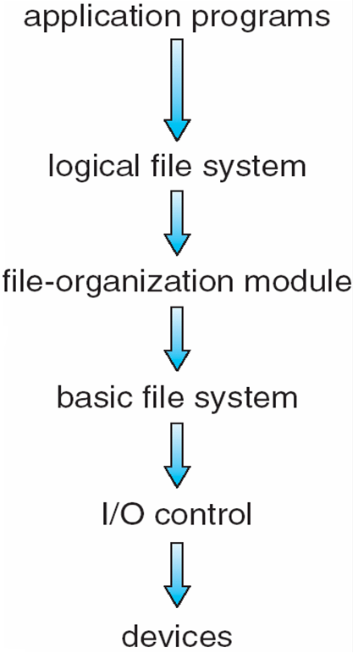
Layered File System

Slide 9
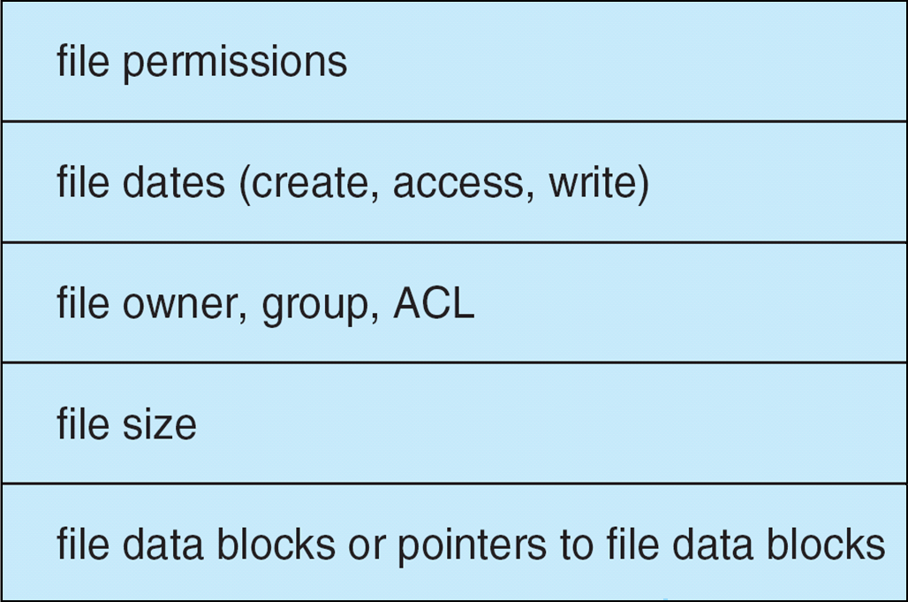
A Typical File Control Block

Slide 10
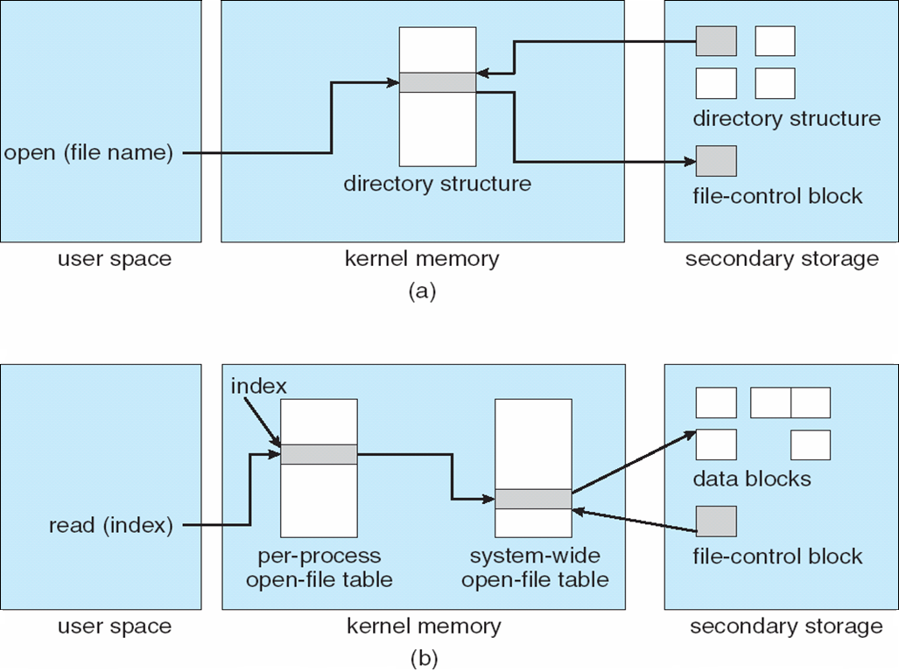
In-Memory File System Structures

Slide 11
Allocation Methods - Contiguous
An allocation method refers to how disk blocks are allocated for files:
Contiguous allocation – each file occupies set of contiguous blocks
Best performance in most cases
Simple – only starting location (block #) and length (number of blocks) are required
Problems include finding space for file, knowing file size, external fragmentation, need for compaction off-line (downtime) or on-line

Slide 12
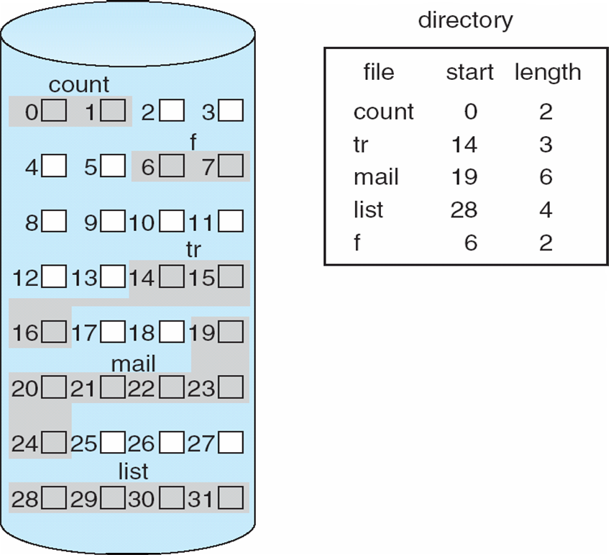
Contiguous Allocation of Disk Space

Slide 13
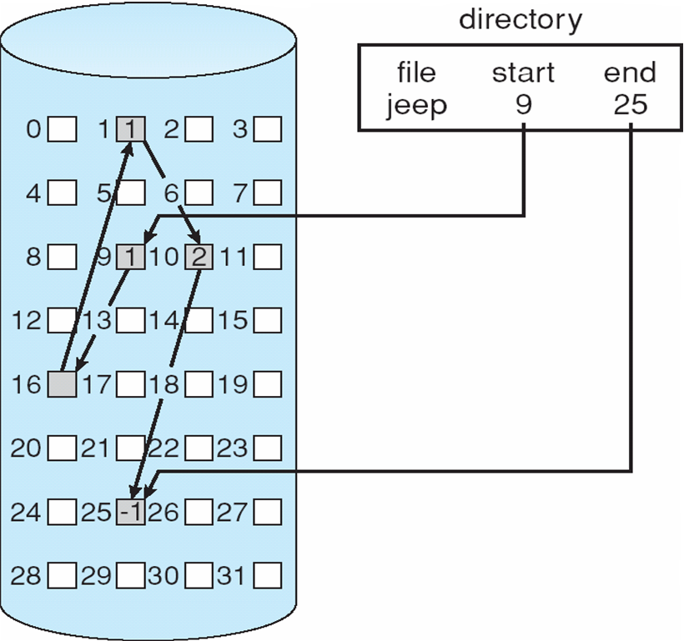
Linked Allocation

Slide 14
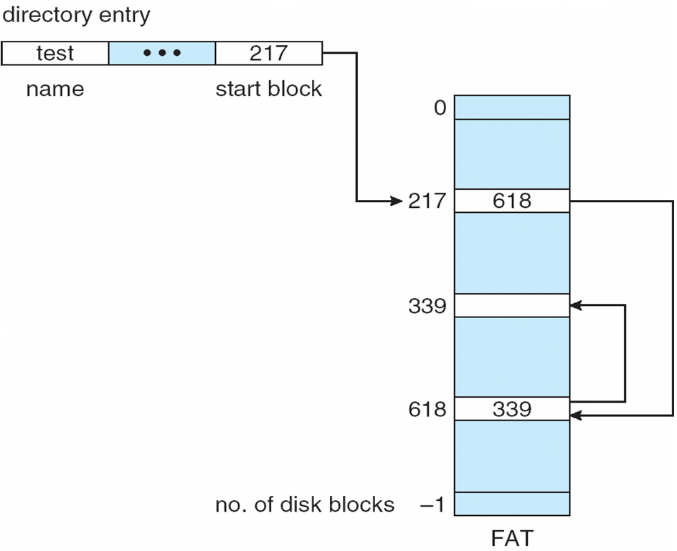
File-Allocation Table

Slide 15
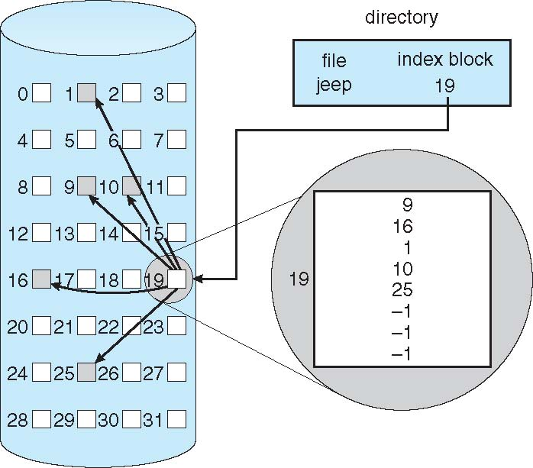
Example of Indexed Allocation

Slide 16
Indexed Allocation – Mapping (Cont.)

outer-index
index table
file

Slide 17
Free-Space Management
0
1
2
n-1
…

1 ⇒ block[i] free
0 ⇒ block[i] occupied
bit[i] =

Slide 18
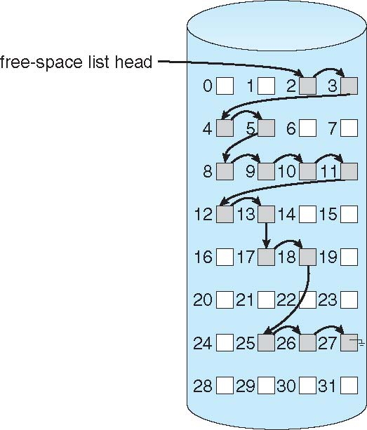
Linked Free Space List on Disk

Slide 19
Conclusion
This lecture makes the student familiar with File sharing, space allocation and free disk management.

Slide 20
Video Link
https://www.youtube.com/watch?v=bq3_uT5Z424

Slide 21
References
https://www.includehelp.com/operating-systems/file-management-in-operating-system.aspx#:~:text=A%20file%20is%20collection%20of,modifying%20and%20deleting%20the%20files.
https://www.tutorialspoint.com/operating_system/os_file_system.htm
https://www.unf.edu/public/cop4610/ree/Notes/PPT/PPT8E/CH12-OS8e.pdf
https://www.javatpoint.com/os-file-system

